Slide 1

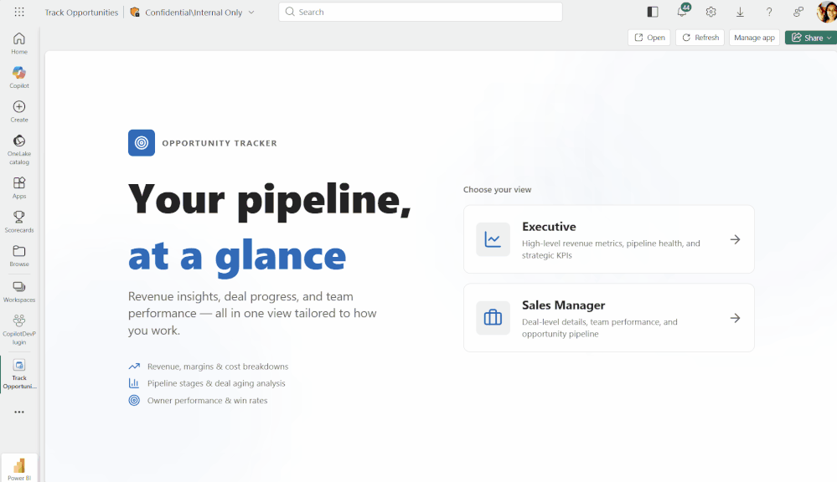
Microsoft Fabric Apps
INTERNAL BRIEFING · NOVEMBER 2026
Custom data applications — built with AI, hosted and governed inside Microsoft Fabric
Prepared by Kaja · Commercial Solutions Analytics
A real Fabric App running in the Fabric portal. Source: element61

Slide 2



Limitations of today’s Power BI reports
THE PROBLEM STATEMENT
IN ONE SENTENCE
1
Insight without action
Acting on a number means another portal, e-mail or spreadsheet
Our reports show what is happening. Acting on it happens somewhere else.
2
No place for user input
Targets, plans, approvals and comments live away from the data
3
Fixed canvas and visuals
Layout and interactions stop at what Power BI offers
E-mail
4
No guided workflows
Excel
Multi-step journeys rely on fragile bookmarks and buttons
Power BI report
Another portal
5
Hard to brand for customers
A fully branded customer portal needs embedding and custom code
Fabric Apps close the gap: insight, input and action in one governed app, on the data we already trust.
Translytical task flows now allow small write actions in reports, not full workflows
The problem statement

Slide 3










What is a Fabric App?
02 · WHAT AND WHY
A new Fabric item that hosts a custom web application with its own database, sign-in and data access, built on our Fabric data. Public preview since 2 June 2026.
TODAY · POWER BI REPORT
NEW · FABRIC APP, ALONGSIDE REPORTS
Read only
Read and write
Reads only through a semantic model
Reads the same model and other Fabric stores directly, and writes back where the store allows it
Power BI report
Fabric App
standard visuals
+
custom web pages · own sign-in · data API · functions
DAX query
DAX query
Semantic model
Semantic model
Warehouse
Fabric SQL database
App’s own database
Lakehouse
measures · RLS · data
read only
read · write
read · write
read · write
read only
↔ read and write · → read only · Data apps need the model in Fabric or Power BI, not AAS
02 · What and why

Slide 4
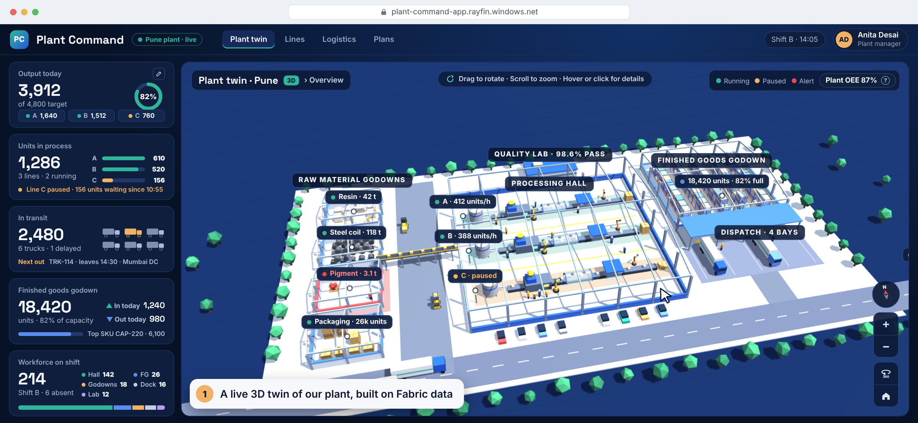
What a Fabric App can do, in one minute
02 · WHAT AND WHY · DEMO
Notes:
Before any detail, here is what a Fabric App can do. This is an illustrative app called Plant Command: a live 3D twin of our plant, built in our own design on Fabric data, with the key numbers on the left. One: at the top level we see the whole site: four raw-material godowns, the processing hall with three lines, the finished-goods godown, dispatch and trucks on the road. Two: like a map, the user can rotate it a full 360 degrees and zoom in and out. Three: zooming in shows more detail. Each godown shows its stock, how full it is and days of cover, and hovering shows more, such as the next steel delivery. Four, act in place: pigment is low, so the manager clicks that godown and raises a purchase request; it's saved to the app's SQL database. Five: she double-clicks to fly into the processing hall and zooms into Line B to see every step, from mixing to packing. Line C is paused at moulding, and hovering shows why. Six, capture input: she raises today's target from 4,800 to 5,200 with a comment, saves a draft and publishes it, and the KPI updates for everyone. Seven: the Logistics tab flies to finished goods and dispatch; hovering a truck or a row shows its load and ETA, including the late one. Eight, a guided flow: clicking Line C opens a wizard to schedule maintenance; a server-side function checks the other lines can still meet the target, and the plant head approves it. Nine: every number can explain how it is calculated, like OEE here. The 3D view is ordinary web code bundled into the app; Fabric supplies the data, sign-in and write-back. The plant, people and numbers are made up. The clip loops.

Slide 5








What Fabric Apps bring us
02 · WHAT AND WHY
CLOSES THE FIVE GAPS
Insight without action
No place for user input
Fixed canvas and visuals
No guided workflows
Hard to brand
Act in place
Capture input
Any design
Guided flows
Our own brand
Forms and write-back next to the numbers
Plans, targets and comments saved as data
Our own layout, navigation and visuals
Wizards, approvals and server functions
Our look and feel; can be embedded in our portal
DATA
PLATFORM
BUILD
Same model
No servers
Fast with AI
Measures reused; RLS still applies
Hosting, scaling, API run by Fabric
Live URL in minutes; agents help build
Many sources
Governed and secure
Real code
Models, lakehouses, warehouses, SQL
Fabric sign-in, item permissions, metrics
Typed, in our Git; open-source SDK
OneLake copy
Agent-ready
App data mirrored for reporting
Runs on capacity
Backend and state for AI agent apps
Uses our Fabric capacity, like other items
Cleaner models
No report-only measures, columns or field parameters
Data apps on our current AAS models need the migration first (section 05)
02 · What and why

Slide 6





Evolution and momentum
02 · WHAT AND WHY
● IN PREVIEW
2025
2 Jun 2026
28 Sep 2026
Nov 2026
Today
Actions in reports
Fabric Apps launch
Beyond capacity
Maturing fast
Public preview
Translytical task flows add write actions
Public preview at Microsoft Build
Pro and PPU announced at FabCon Europe
Rayfin 1.36: connectors, metrics, pipelines
Not GA yet; details still changing
MICROSOFT IS INVESTING
WHAT MICROSOFT SAYS
Inside Power BI: an app builder, same technology
“The distinctions between a dashboard and an app are disappearing.”
Pro and PPU: up to 1 GB per app, no extra cost
Arun Ulag, EVP Azure Data, Microsoft · Sep 2026
Open source: Rayfin SDK with AI agent plugins
“Since the initial launch in June 2026, thousands of developers have used Fabric Apps to build AI-powered business applications, operational workflows, and custom experiences on governed data.”
Shipping fast: Rayfin v1.36 by November 2026
Drag-and-drop vs code is the only trade-off. With AI agents, an app does what our reports do, and much more.
02 · What and why

Slide 7






















How a Fabric App gets built
02 · WHAT AND WHY
On the builder’s laptop
VS Code · Node.js · Git
In Microsoft Fabric
our workspace
1
Describe
2
Scaffold
3
Build
4
Deploy
5
Share
Builder
AI agent
AI agent
Rayfin CLI
AI agent
Builder
Rayfin CLI
Entra sign-in
Builder
Users
and others
$ npm create
$ npx rayfin dev
$ npx rayfin up
Run and interact access
@microsoft/rayfin@latest
Builder describes the screens, data and rules
rayfin/rayfin.yml
Agent writes pages, data model and functions
Creates the Fabric App item
Users get Run and interact on the item
rayfin/data/schema.ts
Syncs settings from rayfin.yml
We prompt in plain English; no code yet
src/ pages
Pages run locally; backend runs in Fabric
They sign in with Entra and open the URL
AGENTS.md
Creates SQL tables from our data model
Agent uses the Rayfin skills and docs
React or Vue template
Builder reviews; every change goes to Git
Changes: commit, then rayfin up again
Already runs as-is
Builds and uploads pages
OUTPUT
An agreed plan
OUTPUT
A starter project
OUTPUT
App on localhost
OUTPUT
Live app URL
OUTPUT
Live for users
Every change: edit, preview, deploy
What the agent writes · we review it, and the code is ours
What appears in our workspace
Pages
Data model
Settings
Fabric App item
app URL for users · backend URL for APIs
React or Vue screens
becomes SQL tables
Functions
rayfin.yml: sign-in, hosting
server-side logic
SQL database
Sign-in
links to our data
our tables
Entra users
Rayfin: Microsoft’s open-source SDK and CLI · first deploy 2–5 min · page redeploy 30–60 s
02 · What and why
Notes:
This is how a Fabric App gets built, in five steps. The top bar shows where each step happens: the first three on the builder's laptop, the last two in our Fabric workspace. Each card shows who does the work, the command, what happens and what comes out. Step 1, describe: the builder tells an AI coding agent, such as GitHub Copilot, Claude Code or Cursor, what screens, data and rules the app needs. The agent plans the app using the Rayfin skills and documentation server, so it follows Microsoft's rules. Step 2, scaffold: the agent runs npm create at microsoft slash rayfin. That creates a ready-made starter project from a React or Vue template: the rayfin folder with the settings file rayfin.yml and the data model, the src folder for the pages, and an AGENTS.md file that tells the agent how to work in the project. Nothing custom yet, but it already runs. Step 3, build and preview: the agent writes the data model, pages and any server functions in TypeScript. npx rayfin dev runs the pages on the laptop while the backend runs in Fabric, so we test against real services. The builder reviews each change and commits it to Git. Step 4, deploy: npx rayfin up signs in with Entra, creates or reuses the Fabric App item in our workspace, syncs the settings from rayfin.yml, creates the SQL tables from our data model, builds the pages and uploads them, and prints the live URL. A first deploy takes two to five minutes. Step 5, share and change: users need Run and interact permission on the app item; they sign in with Entra and open the URL. To change anything we go round the loop: edit, preview, commit and run rayfin up again; a page-only redeploy takes thirty to sixty seconds. Underneath: on the left, the four things the agent writes, which we review and own; on the right, what appears in the workspace: the Fabric App item with its app and backend URLs, a SQL database for our tables, sign-in for Entra users, and links to our models, lakehouses and warehouses. Builders need Node.js, Git, VS Code and Contributor access to the workspace.

Slide 8










One item type, three kinds of app
03 · THREE KINDS OF APP
1
Operational
2
Data app
3
Hybrid
Users create, edit and approve records
Users explore analytics in a custom design
Users analyse, then act on what they see
Fabric App
Fabric App
Fabric App
GraphQL · read & write
DAX · read only
DAX · read
GraphQL · write
App’s own SQL DB
Semantic model(s)
Semantic model
App’s SQL DB
BEST FOR
BEST FOR
BEST FOR
Approvals
Requests and trackers
Executive cockpits
Guided analysis
Action plans on KPIs
Data entry
Customer KPI portals
Targets and forecasts
Comments
The app owns its data
The model owns the data; the app reads
Reads the model, writes user input
Same item, sign-in, security and deployment. Choose by where the data lives and whether users write.
Microsoft Fabric Apps · Briefing
03 · Three kinds of app

Slide 9



Operational app: people create and change records
03 · THREE KINDS OF APP
How it works
A REQUEST’S JOURNEY
We describe tables and access rules in TypeScript. Fabric creates the SQL database, a GraphQL API and the security checks.
1
Create
Requester
The requester fills in a short form
Who sees what
2
Save
App
Role rules run on the server: requesters see their own rows, approvers see only the rows routed to them.
A row lands in the app’s SQL database
3
Review
Approver
Typical uses
It appears in the approver’s queue
Requests and approvals
Issue logs
Budget and forecast input
Decide
4
Approve or reject; status and log update
Approver
Data-quality sign-off
Catalogues
No semantic model needed. It works today, whatever our AAS setup. Next slide: the app in action.
Microsoft Fabric Apps · Briefing
03 · Three kinds of app
Notes:
An operational app is for people who create and change records: requests, approvals, logs, plans. We describe the tables and the access rules in TypeScript, and Fabric creates the SQL database, the GraphQL API and the security checks. Role rules run on the server, so a requester only ever sees their own requests and an approver only sees what is routed to them. A request goes through four steps: create, save, review, decide. Because it doesn't need a semantic model, our AAS setup doesn't block it. The next slide shows one in action.

Slide 10
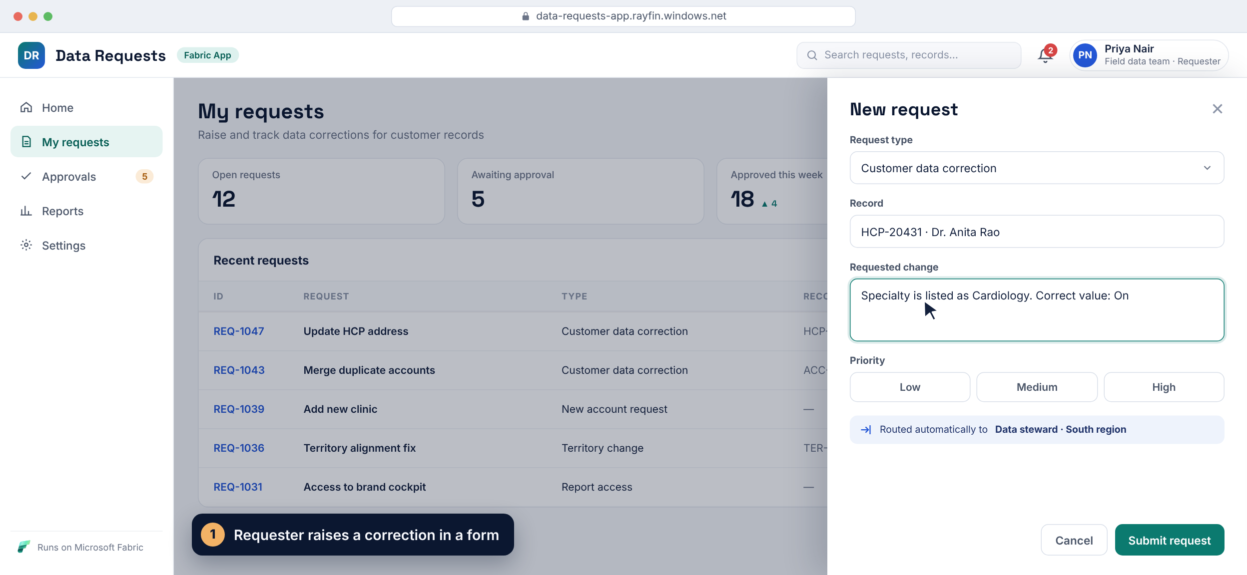
Operational app in action
03 · THREE KINDS OF APP · DEMO
Notes:
This is an illustrative operational app built on the Fabric Apps pattern: a data correction request with approval. Step 1: Priya, a requester, clicks New request, picks the type, the customer record and the change, sets the priority and submits. Notice it's routed automatically to the right data steward. Step 2: the request is saved to the app's own SQL database and appears in her list. Step 3: Daniel, the approver, sees only the requests routed to him; Priya's is flagged as new. Step 4: he reviews the before and after, approves, and the status, the activity log and Priya's notification update. Every rule runs on the server, and the data is copied to OneLake so Power BI can report on it. The clip loops.

Slide 11

Data app: custom analytics on a semantic model
03 · THREE KINDS OF APP
How it works
REPORT → DATA APP
Each visual sends a DAX query to the model and draws the result with web charts. One app can use several models.
LAYOUT
Fixed canvas → any layout we design
Logic and security stay in the model
VISUALS
Measures are reused by name. Queries run as the signed-in user, so model RLS applies.
Power BI visuals → any web chart
NAVIGATION
Pages, bookmarks → guided steps
Typical uses
Executive cockpits
Guided analysis
Customer KPI portals
BRANDING
Report theme → our full brand
Field team dashboards
DATA
Semantic model → the same model, unchanged
Needs the model in Fabric or Power BI. Our AAS-hosted models need migrating first (section 05). Next slide: the app in action.
Microsoft Fabric Apps · Briefing
03 · Three kinds of app
Notes:
A data app puts our own front end on a semantic model. Each visual sends a DAX query to the model and draws the result with web charts; one app can use several models. The measures are reused by name and every query runs as the signed-in user, so the model's RLS still applies. Compared with a report, we control the layout, the visuals, the navigation and the branding, while the data stays in the same model. The catch for us: the model must be published in Fabric or Power BI, so our AAS-hosted models need migrating first. The next slide shows one in action.

Slide 12
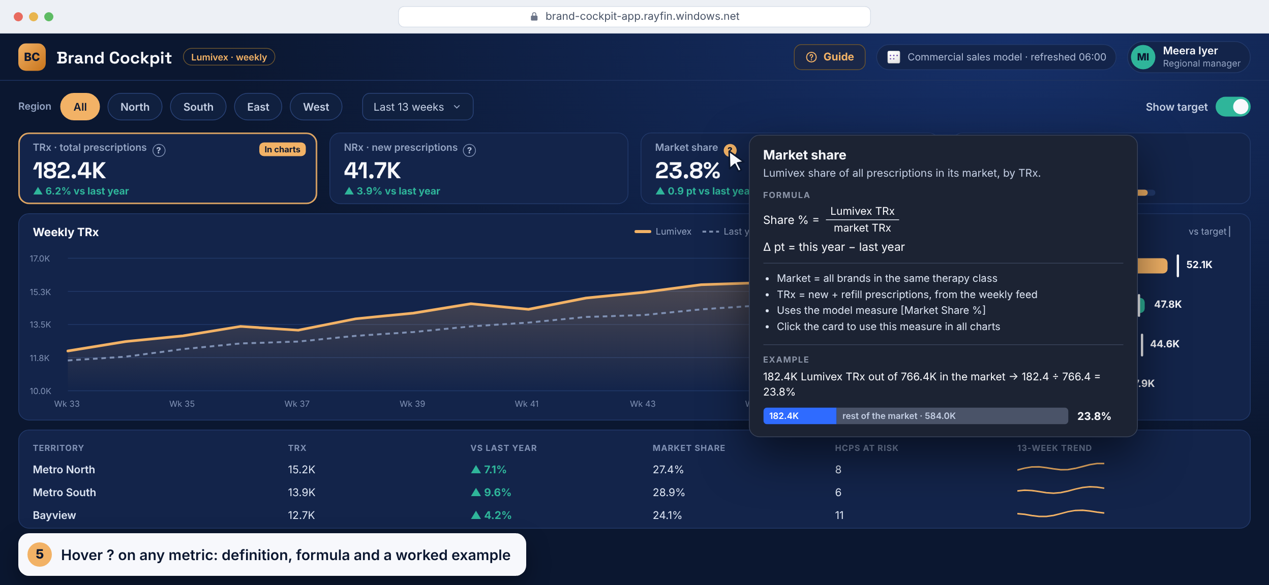
Data app in action
03 · THREE KINDS OF APP · DEMO
Notes:
This is an illustrative data app on a semantic model: a brand performance cockpit in our own design. Step 1: every number and chart is a DAX query on the commercial sales model; nothing is copied. Step 2: Meera, a regional manager, picks South. The app re-queries the model as her, so model RLS applies, and the KPIs, trend and territory bars update. She hovers week 43 for the detail. Step 3: she clicks Coastal to drill down, using the same measures and the same security. Step 4: she turns on targets, and the bars show who is above or below plan. Step 5: hovering the question mark on Market share shows its definition, formula and a worked example. Step 6: clicking the NRx card switches every chart to NRx. Steps 7 and 8: the Guide button opens a built-in FAQ, a how-to-use page and a Calculations page with every formula and an example. That help text is written once in the app and must be reviewed by us, not left as AI output. The layout, charts and branding are ours, while the logic stays in the model. The brand, names and numbers are made up for the demo. The clip loops.

Slide 13
Hybrid app: analyse, then act on what you see
03 · THREE KINDS OF APP
How it works
THE WRITE-BACK LOOP
Visuals read the semantic model with DAX. Plans, comments and issue reports are written to a SQL database through GraphQL.
Read
1
Model
Visuals query the model as the user
Who sees what
Act
2
The user adds a plan, target or comment
User
Model RLS limits what each user reads. Role rules limit what they can write and see.
3
Save
App
Typical uses
A row lands in a SQL database
Action plans on KPIs
Targets and forecasts
Comments on numbers
Flow back
4
It reaches OneLake; the model picks it up
OneLake
Data-issue reports
Nobody writes to the semantic model. Reads need the model in Fabric or Power BI; writes work today. Next slide: the app in action.
Microsoft Fabric Apps · Briefing
03 · Three kinds of app
Notes:
A hybrid app combines the two: users analyse the numbers and act on them in the same place. Visuals read the semantic model with DAX, as each signed-in user, so RLS applies. What users enter, such as plans, targets, comments or reports of wrong numbers, is written to a SQL database through GraphQL, usually the app's own database, or an existing warehouse or SQL database. Role rules decide who can write and who sees what was written. Nothing writes to the semantic model directly. Saved rows reach OneLake, and a Direct Lake model shows them soon after; an Import model shows them after its next refresh. The read side needs the model in Fabric or Power BI, so our AAS models need migrating first; the write side works today. The next slide shows a feedback flow in action.

Slide 14
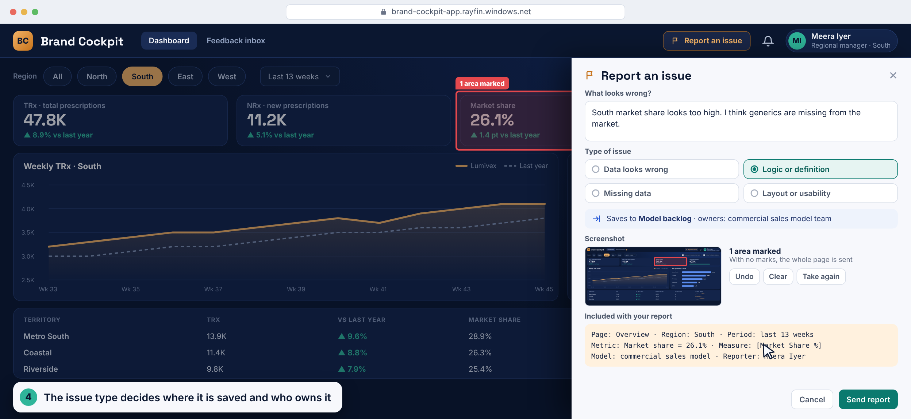
Hybrid app in action
03 · THREE KINDS OF APP · DEMO
Notes:
This is an illustrative hybrid app: the same brand cockpit, now able to write. Step 1: the dashboard reads the commercial sales model, and the header shows it also writes to a feedback database. Step 2: Meera thinks South market share looks wrong. She clicks Report an issue and drags a box around the number. Step 3: she writes what looks wrong; the app captures the page, filters, metric, value and measure automatically. Step 4: she picks the issue type, and the type decides where the report is saved and who owns it: here, the model backlog for the semantic model team. Step 5: it is saved as a row in a SQL database, and the KPI now shows Under review for everyone. Step 6: Ravi, the model owner, sees it in his feedback inbox with the screenshot and context. Step 7: he sets it to Investigating and replies; that is written back too, and Meera is notified. Step 8: back on the dashboard, anyone reading the metric sees its status and the reply. The fix itself happens in the model. Names and numbers are made up for the demo. The clip loops.

Slide 15



Where Fabric Apps sit among our options
02 · WHAT AND WHY
↑ Code and skills needed
Own Azure web app
we run everything
Fabric App — operational
custom app with write-back
Fabric App — data app
custom analytics
Translytical task flow
report + function write-back
Paginated report
Power Apps
pixel-perfect print
low-code forms
Power BI report
no code; visuals + DAX
Freedom of design and interaction →
Fabric Apps fill the gap between reports and fully custom web apps · positions are indicative
02 · What and why

Slide 16













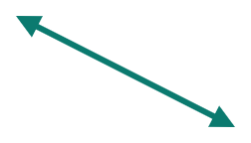




What a Fabric App is made of
02 · WHAT AND WHY
FABRIC APP ITEM
one item in our workspace · one link to share
Our Fabric data
Front end
Back end
set up in rayfin.yml
run by Microsoft
Semantic models
in the browser
DAX · as the user
2
Auth
Hosting
checks the sign-in token on every call
serves the pages at the app URL
Lakehouses
Users
3,912
87%
SQL endpoint
3
open the app URL
Warehouses
Save
Functions
Data API
Entra ID
1
5
our server-side logic, runs as the app
reads, writes and checks rules
tables
single sign-on
Pages, forms and charts in React or Vue
SQL databases
4
tables
Talks to the back end only through the Rayfin SDK
App’s own SQL database
Holds no secrets and no data of its own
child item · tables come from our data model · read and write
Read only
Read and write
reached through connectors
How one Save reaches the database · numbers match the diagram
1
Click Save
2
Send
3
Check
4
Write
5
Confirm
User fills in the form in the page
SDK sends the change with their sign-in token
Sign-in, role and data rules are checked
The row is saved in the app’s SQL table
Page updates; others see it on their next read
Microsoft Fabric Apps · Briefing
02 · What and why
Notes:
A Fabric App has three parts, all inside one Fabric App item in our workspace, plus connections to the data we already have. First, the front end: the pages users see in their browser, written in React or Vue. It holds no secrets and no data of its own; it talks to the back end only through the Rayfin SDK. Second, the back end, which Microsoft runs and patches for us, configured in one file, rayfin.yml. It has four services. Auth checks the user's Entra sign-in token on every call. Hosting serves the pages at the app URL. The Data API reads and writes rows and applies our permission rules. Functions run our own server-side logic, as the app's identity, for anything multi-step. Third, the app's own SQL database, a child item whose tables come from our data model; this is where the app writes. On the right is the data we already have, reached through connectors: semantic models with DAX, using the user's own access, and lakehouses through their SQL endpoint are read only; warehouses and SQL databases can be read and written. The numbers trace one Save. One: the user fills in a form and clicks Save. Two: the SDK sends the change to the back end with the user's sign-in token. Three: the back end checks the sign-in, the role and the data rules. Four: the row is written to the app's SQL table. Five: the result comes back and the page updates; other users see the new value the next time their page reads it. Reads work the same way in reverse: the page asks, the back end checks, and data comes back from our tables, models or lakehouses.

Slide 17





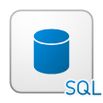














Operational app: architecture options
03 · THREE KINDS OF APP
Microsoft Fabric
Read only
Read and write
Server logic
1
Fabric App
GraphQL
GraphQL Data API
SQL
App’s SQL database
Operational app · forms, lists, approvals
generated from our schema · role rules on every call
child item · read · write · auto-copied to OneLake
connectors · app identity by default, or per user
2
OPTIONAL
Warehouse
SQL database
Lakehouse
data that already lives in Fabric
read · write
existing · read · write
SQL endpoint · read only
3
invoke
Functions
Functions also reach, as the app identity:
server-side TypeScript · checks, secrets
Warehouse
SQL database
OneLake files
Azure SQL
Azure AI Foundry
Signs in with Microsoft Entra ID
User
The app owns its data. Role rules run on the server on every call. No semantic model is needed, so our AAS setup doesn’t block it.
browser, or embedded in our portal
Add a semantic model and it becomes a hybrid app · Sources: Microsoft Learn, Rayfin docs v1.36
03 · Three kinds of app
Notes:
Operational is the default kind: people create and change records. 1: the app calls its own GraphQL Data API, generated from our TypeScript schema, which checks role rules on every call and stores data in the app's own SQL database. That database is a child item and is copied to OneLake automatically, so Power BI can report on it. 2: optionally, connectors give typed access to data that already lives in Fabric: an existing warehouse or SQL database (read and write) or a lakehouse SQL endpoint (read only). Connectors run as the app identity by default, or as each user if we switch them to delegated. 3: functions are server-side TypeScript for checks, secrets and calls to other systems; they reach Fabric SQL items, OneLake files, Azure SQL and Azure AI Foundry as the app identity. Eventhouse, Microsoft 365 and data agent connectors exist but are experimental and can't be added yet.

Slide 18









Data app: architecture options
03 · THREE KINDS OF APP
Microsoft Fabric
Read only
Read and write
Server logic
3
2
Functions
T-SQL
Lakehouse
Warehouse
server-side TypeScript · shape data, call Azure AI
as the app
SQL analytics endpoint · read only
tables and views · read here
invoke
GraphQL connectors · read
1
Fabric App
DAX queries
Semantic model
Data app · our charts, our layout
as each user
published in Fabric or Power BI (not AAS) · measures and RLS reused · one or many models
EXPERIMENTAL
Eventhouse
Data agent
can't be added yet; Microsoft 365 connectors are in the same state
KQL queries on live data
questions in plain language
Signs in with Microsoft Entra ID
User
Logic and security stay in the model. Queries run as each user, who needs Read and Build on it. Nothing is copied.
sees only what model RLS allows
Functions can’t query semantic models · Sources: Microsoft Learn, Rayfin docs v1.36
03 · Three kinds of app
Notes:
A data app gives our semantic models a custom front end. 1: the core path. Each visual sends a DAX query through the semantic model connector, always as the signed-in user, so the model's measures and RLS apply. Users need Read and Build on the model, and the model must be published in Fabric or Power BI; our AAS-hosted models need migrating first. One app can use several models. 2: the app can also read a lakehouse through its SQL analytics endpoint, or a warehouse, through GraphQL connectors. In a data app these are reads; writing is the hybrid pattern on the next slide. 3: functions are server-side TypeScript. They can query a lakehouse or warehouse in T-SQL as the app identity, shape or combine data, or call Azure AI, but they can't query semantic models. Eventhouse (KQL) and data agent connectors exist but are experimental and can't be added yet.

Slide 19














Hybrid app: architecture options
03 · THREE KINDS OF APP
Microsoft Fabric
Read only
Read and write
Server logic
1
Semantic model
DAX
as the user
Which write path?
in Fabric or Power BI, not AAS
Fabric App
Start with 2. Use 3 for shared tables, 4 for checks and logic.
each user’s RLS applies
Hybrid: see the number, then act on it
WRITE · PICK ONE
2
3
4
App’s SQL database
DEFAULT
Warehouse or SQL DB
Function
GraphQL Data API · role rules on every call
a connector writes to existing tables
checks the input, then writes as the app
for new data the app owns
for tables other teams already use
for validation and multi-step logic
The model shows the input
Lands in OneLake as Delta
Saved in a SQL store
Direct Lake: shortly after · Import: next refresh
the app’s database is copied automatically
app DB, warehouse or SQL DB
Signs in with Microsoft Entra ID
User
Nobody writes to the semantic model. Input is saved in a SQL store, lands in OneLake and flows back into the model.
reviews numbers, enters plans and actions
Write path 2 is the default · Sources: Microsoft Learn, Rayfin docs v1.36
03 · Three kinds of app
Notes:
A hybrid app reads the semantic model and writes user input, closing the loop. Read it top to bottom. Path 1, the read path, is the same as a data app: DAX queries run as each signed-in user, so their row-level security applies, and the model must be in Fabric or Power BI, not Azure Analysis Services. In the middle row, pick one write path. Path 2 is the default: the GraphQL Data API saves to the app's own SQL database, with role rules on every call; use it for new data the app owns, such as plans and comments. Path 3: a connector writes into tables of an existing warehouse or SQL database that other teams already use. Path 4: a function checks the input first and then writes as the app, for validation and multi-step logic. The blue band shows how the input gets back into reports: it is saved in a SQL store, lands in OneLake as Delta tables, because the app's database is copied there automatically and warehouse tables already live there, and the model then shows it: a Direct Lake model shortly after, an Import model after its next refresh. Nobody writes to the semantic model directly.

Slide 20














Components and who runs them
04 · ARCHITECTURE
We build
We configure
Microsoft runs
with an AI agent; we review and own it
Microsoft runs it; we set it up
hosted and patched for us
Front end
Authentication
Static hosting
Pages, forms and charts users work with
Entra single sign-on, sessions, user claims
Serves the app at its live URL, up to 100 MB per deploy
Schema and rules
Connectors
Data API
Tables, fields and row-level access rules, in TypeScript
We declare access to models, lakehouses, warehouses and SQL databases
GraphQL generated from our schema; enforces the rules on every call
Function code
rayfin.yml
Trusted server-side code: checks, notifications, secrets
One settings file switches each back-end service on or off
SQL database
Stores app data; a child item, copied to OneLake
We own the code and the settings. Microsoft runs, secures and patches everything underneath, so there are no servers for us to manage.
Functions runtime
Runs our function code on the server
Microsoft Fabric Apps · Briefing
04 · Architecture
Notes:
This slide splits the parts of a Fabric App by who is responsible. On the left, what we build, with an AI agent doing most of the typing and us reviewing and owning the code: the front end, meaning the pages, forms and charts; the schema and rules, meaning our tables, fields and row-level access rules written in TypeScript; and our function code for trusted server-side work such as checks, notifications and anything that needs secrets. In the middle, what we configure while Microsoft runs it: authentication through Entra single sign-on; connectors, where we declare access to semantic models, lakehouses, warehouses and SQL databases; and rayfin.yml, the one settings file that switches each back-end service on or off. On the right, what Microsoft runs and patches for us: static hosting at the live URL, up to 100 MB per deploy; the GraphQL Data API, generated from our schema and enforcing our rules on every call; the app's SQL database, a child item that is copied to OneLake; and the runtime that executes our functions. The bottom line: we own the code and the settings, and Microsoft runs everything underneath.

Slide 21














Fabric App or our own web app?
04 · ARCHITECTURE
stronger option for that need
WHAT MATTERS
Fabric App
Rayfin on Microsoft Fabric
Our own web app
own site, sign-in and database
Data
Builds on lakehouses, warehouses and models in place
Any database, e.g. Snowflake; Fabric data is extra work
Sign-in
Entra single sign-on built in; nothing to run
We set up and run sign-in, sessions and tokens
Who can use it
Entra users with access to the item; no other sign-in
Anyone: customers, partners, any sign-in provider
Back end and rules
API and database generated; rules checked on every call
We build the API, rules and row security, and test them
Running it
Microsoft hosts and patches it; no servers for us
We run hosting, patching, backups, monitoring, on-call
Governance
Inside Fabric: workspace roles, lineage, tenant settings
A separate estate: own audits, reviews, data-copy approvals
Speed to launch
Fast: AI agent, starter project, one-command deploy
Slower: more parts to design, build and secure
Flexibility
Opinionated: managed schema, TypeScript, no raw SQL
Any stack, custom domain, caching, raw SQL, any logic
Maturity, lock-in
Preview; no built-in ALM or private links; tied to Fabric
Mature tools, full CI/CD, private networking; portable
Cost
Uses our Fabric capacity; competes with reports for it
New bills: hosting, Snowflake compute, more engineers
BOTTOM LINE
Choose a Fabric App when
Build our own web app when
internal users, data already in Fabric, reports and actions together
external users, data outside Fabric, or full control needed
Not either-or: Snowflake data can be mirrored into OneLake (GA) and used from Fabric
04 · Architecture
Notes:
Why not just build a normal website? We could: any web stack on any database, for example Snowflake, with our own sign-in. This slide is the honest comparison; green marks the stronger option for each need. Where a Fabric App wins: Data, it builds on the lakehouses, warehouses and semantic models we already have, in place, with no copies, while our own site would need its own pipeline or remote queries to reach that data. Sign-in, Entra single sign-on comes built in, whereas we would set up and run sign-in, sessions and tokens ourselves. Back end and rules, the data API and the app database are generated, and access rules run on the server on every call; on our own we build and test the API and the row-level security, which is easy to get wrong. Running it, Microsoft hosts and patches it, with no servers, backups or on-call for us. Governance, it sits inside Fabric with workspace roles, lineage and tenant settings, rather than a separate estate that needs its own audits and data-copy approvals. And speed: an AI agent, a starter project and a one-command deploy. Where our own web app wins: who can use it, because a Fabric App only accepts Entra users with access to the item, while our own site can serve customers and partners with any sign-in provider. Flexibility: Fabric Apps manage the database schema, need TypeScript on the back end, and don't expose raw SQL or built-in caching; our own site can use any stack, a custom domain and any logic. Maturity and lock-in: Fabric Apps are in preview, with no built-in application lifecycle management, multi-environment tooling or private link support yet, and they tie us to Fabric; a custom site uses mature tools, full CI/CD, private networking, and can move between clouds. Cost depends: a Fabric App runs on capacity we already pay for, but competes with reports for it, while our own site brings new bills for hosting, Snowflake compute and more engineering time. Bottom line: choose a Fabric App for internal users when the data is already in Fabric and reports and actions belong together; build our own web app for external users, data that lives outside Fabric, or when we need full control. And it isn't either-or: Snowflake data can be mirrored into OneLake, which is generally available, and then used from Fabric.

Slide 22






Which tool should we build with?
04 · ARCHITECTURE
Ask in order · stop at the first yes
1
Mainly reading and analysing data?
yes
Power BI report
PICK IT FOR
AVOID WHEN
A standard report meets the layout, interaction and audience
Build effort
Dashboards and self-service; works on our AAS models
Users must enter data, or need a fully custom layout
no
Only a small write action inside a report?
yes
Translytical task flow
PICK IT FOR
AVOID WHEN
2
Users stay in the report; a button writes back via a function
Multi-step forms or workflows; writes only to Fabric data stores
Approve a row, add a comment, adjust a value
Build effort
no
Low-code makers or Microsoft 365 connectors?
yes
Power Apps
PICK IT FOR
AVOID WHEN
3
Forms and approvals with Microsoft 365, Power Automate
Large datasets or rich analytics; premium licences per user
SharePoint lists, Outlook, Teams approvals
Build effort
no
4
Custom app on Fabric data, for our staff?
yes
Fabric App
PICK IT FOR
AVOID WHEN
A data app, operational app or hybrid
Build effort
Our own design on Fabric data, built with code and AI
Model still on AAS, external users, or no developers; in preview
no
5
External users, outside data, full control?
yes
Our own web app
PICK IT FOR
AVOID WHEN
Customer portal, Snowflake data, custom domain
Build effort
Any users, any stack and database, complete control
No team to build and run sign-in, API, security and hosting
Most needs stop at question 1 · still unsure? Prototype in a report first
04 · Architecture
Notes:
A Fabric App is not a super app. It is one of five options, and this slide shows how to choose. Ask the questions in order and stop at the first yes. One: is the need mainly reading and analysing data, and can a standard Power BI report meet the layout, interaction and audience? Then build a report: it is the fastest, self-service, and works on our existing AAS models; avoid it only when users must enter data or need a fully custom layout. Two: does it need only a small write action inside a report, such as approving a row, adding a comment or adjusting a value? Then use a translytical task flow: users stay in the report they know and a button runs a Fabric user data function that writes back; it is not for multi-step forms or workflows, and it writes only to Fabric data stores such as a SQL database, warehouse or lakehouse. Three: do the makers prefer low-code, or does it need Microsoft 365 connectors like SharePoint lists, Outlook or Teams approvals? Then Power Apps, with Power Automate for the flows; avoid it for large datasets or rich analytics, and remember premium connectors need a licence per user. Four: is it a custom app or custom analytics on Fabric data for our own staff, built with code and AI? Then a Fabric App: a data app if it is read-only, an operational app if it manages records, a hybrid if it does both. Avoid it while the model is still on AAS, for external users, when there are no developers, and keep in mind it is still in preview. Five: if none of those fit, because the users are outside the company, the data lives outside Fabric, or we need full control of the stack, build our own web app, but only with a team to build and run sign-in, the API, security and hosting. The dots show relative build effort. Most needs still stop at question one; if unsure, prototype in a report first and move to an app only when the report's limits block real users, not because apps look modern.

Slide 23
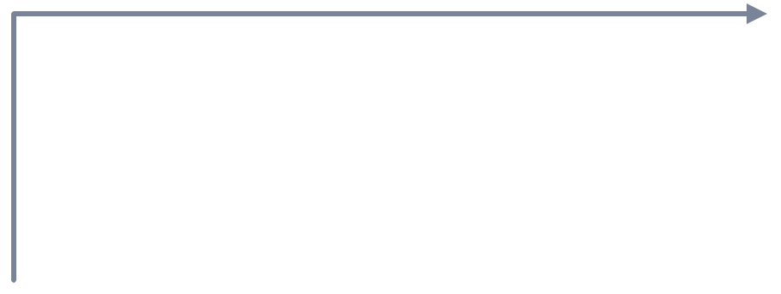
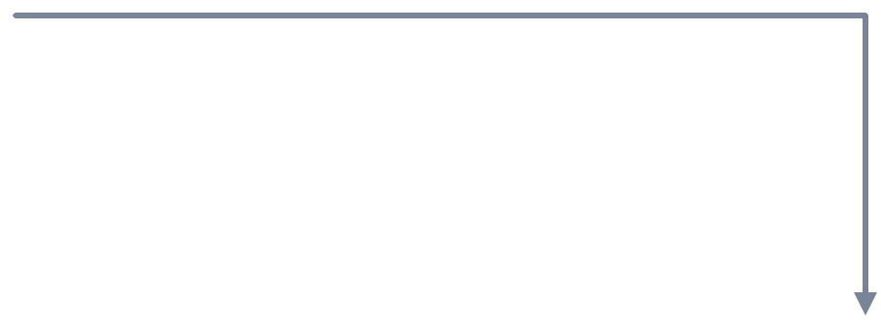
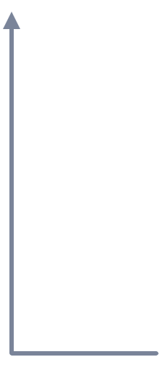
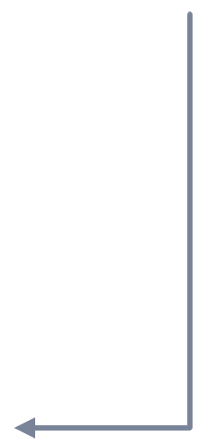
Hybrid app: the write-back loop
03 · THREE KINDS OF APP
1 · Data app page
reads the model (DAX)
5 · Semantic model
picks it up
Input becomes analytics
2 · User acts
“Create action” form
The model is never written to directly. With an Import model, new input appears after the next refresh; Direct Lake or DirectQuery shows it sooner.
4 · OneLake copy
mirrored, near real-time
3 · App SQL database
saved via GraphQL
Microsoft Fabric Apps · Briefing
03 · Three kinds of app

Slide 24



Rayfin: the engine behind every Fabric App
04 · ARCHITECTURE
SDK
Command line
Managed service
Code libraries the app uses to read and write data, sign users in, call functions and query semantic models.
Creates projects, runs them locally and deploys everything with one command: npx rayfin up.
Runs inside Fabric: database, GraphQL API, sign-in and hosting. Microsoft operates and updates it.
NORMAL SDK VS RAYFIN
OPEN SOURCE
A normal SDK helps you call a backend you already built. Rayfin creates and runs the backend for you — Backend-as-a-Service.
MIT licence · github.com/microsoft/rayfin · version 1.36.2
Microsoft Fabric Apps · Briefing
04 · Architecture

Slide 25
Request flow: operational app
04 · ARCHITECTURE
Browser
the app’s pages
Sign-in
Fabric · Entra ID
Data API
GraphQL, managed
SQL database
the app’s tables
1 · Fabric single sign-on
2 · Token: who you are
3 · GraphQL call + token
4 · Checks role rules, adds a row filter
5 · SQL query, filtered
6 · Allowed rows only
7 · JSON → page renders
Rules run on the server for every call, so nobody can bypass them from the browser.
Microsoft Fabric Apps · Briefing
04 · Architecture

Slide 26
Request flow: data app
04 · ARCHITECTURE
Visual
chart in the app
Fabric host
proxy or connector
Query API
Execute Queries
Semantic model
measures + RLS
1 · DAX query as the user
2 · Execute Queries call
3 · Runs the DAX
4 · Applies RLS for this user
5 · Result rows
6 · JSON, up to 100k rows
7 · Chart drawn, cached
No data is copied and no logic is rebuilt: the model’s measures and RLS do the work.
Microsoft Fabric Apps · Briefing
04 · Architecture

Slide 27






Business advantages
02 · WHAT AND WHY
Custom experiences
Act on the data
One governed platform
Any layout, guided flows and our own branding — beyond the visual and layout limits of reports.
Input, approvals, comments and targets captured next to the numbers — and stored in Fabric.
Apps live in workspaces with Fabric permissions, capacity, tenant settings and monitoring — no shadow IT hosting.
No servers to run
Live, no copies
Faster with AI
Database, sign-in, data API and hosting are managed services. No virtual machines, no patching.
Data apps query the semantic model live as each user; model security applies. One version of the truth.
Templates and agent skills let a BI developer reach a working prototype in hours, not weeks.
Microsoft Fabric Apps · Briefing
02 · What and why

Slide 28
A real Fabric App: Opportunity Tracker
SHOWCASE
WHAT YOU SEE
Role-based landing page, KPI cards, tabs for finance, opportunities and offers, and a calendar view
WHERE IT RUNS
Inside the Fabric portal, with Open, Refresh and Manage app in the toolbar — and at its own URL
WHY IT MATTERS
An app-like experience no report canvas could give — on governed Fabric data
Source: element61, “Fabric just became an application platform”
02 · What and why

Slide 29
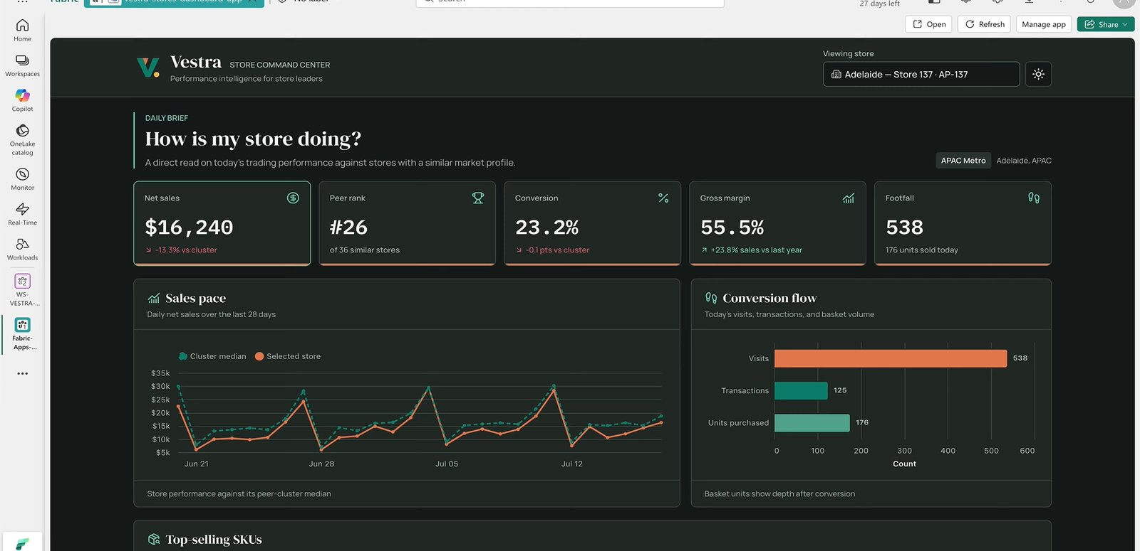
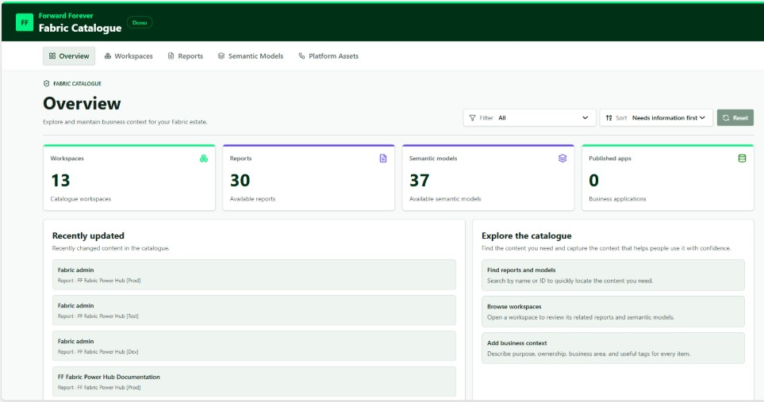
What teams are building
SHOWCASE
Data app on a semantic model
Operational app
Store command centre: KPIs, peer comparison, funnel, top SKUs — with an action-plan write-back. Source: Mehdi Maachou (YouTube)
Fabric Catalogue: teams add business context to workspaces, reports and models, with AI suggestions. Source: Forward Forever
Microsoft Fabric Apps · Briefing
02 · What and why

Slide 30
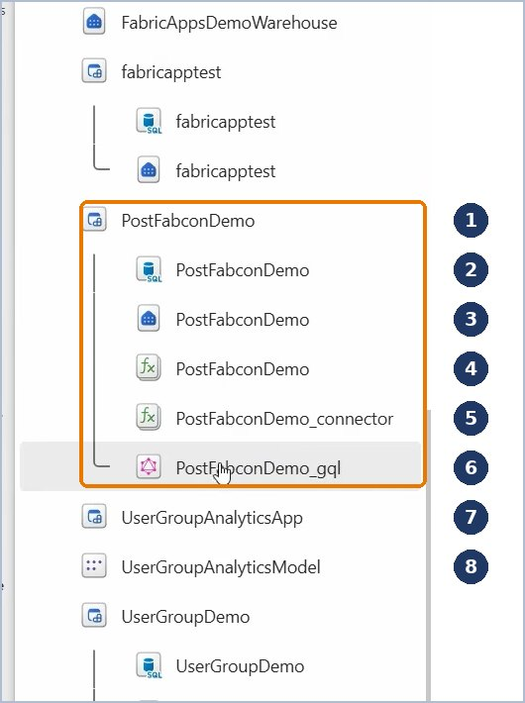
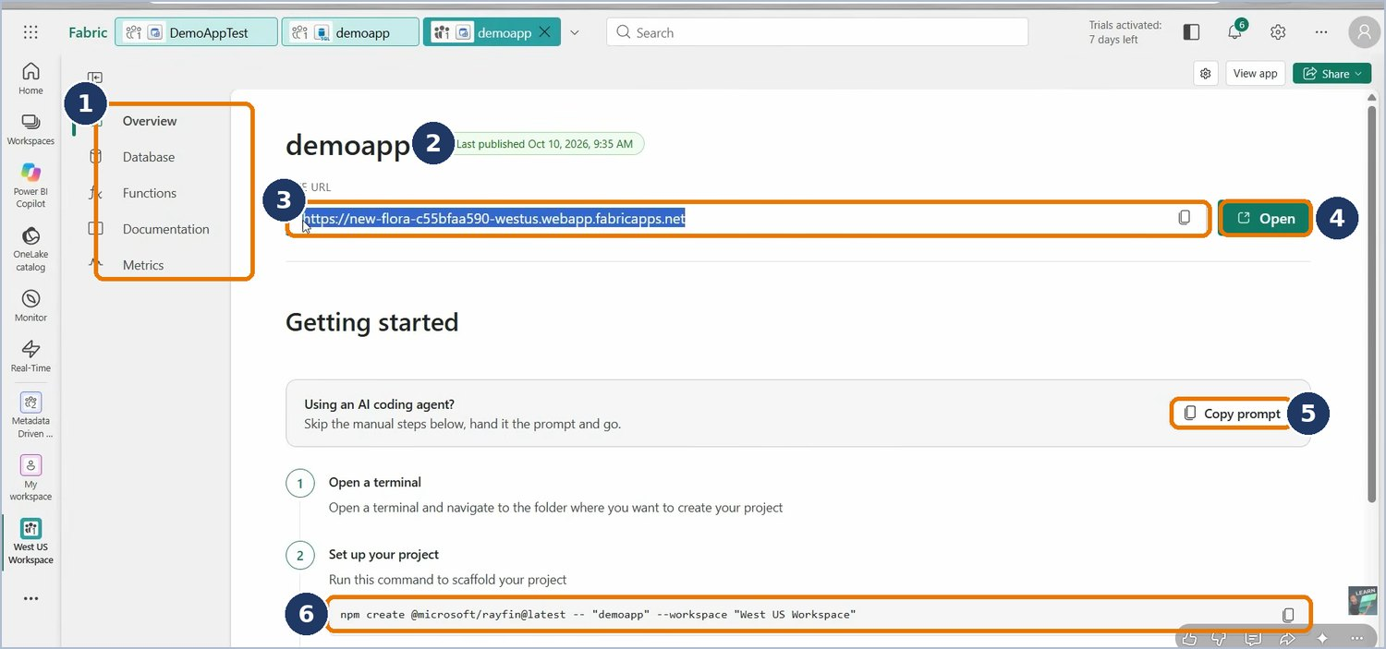
What lands in the workspace
04 · ARCHITECTURE
WORKSPACE TREE AFTER DEPLOY
THE APP’S PAGE IN FABRIC
1
App item (the parent)
2
SQL database
3
Its SQL analytics endpoint
4
Functions (UDF item)
5
Connector bridge
6
GraphQL connector
7
Data app: no children
8
The model it reads
Database, Functions, Metrics tabs
1
2
Last published
3
Live URL to share
4
Open the app
5
Copy prompt for an AI agent
6
Command to start the project
Screenshots: Fabric portal (preview, Oct 2026)
04 · Architecture

Slide 31



Sign-in and identity
04 · ARCHITECTURE
Fabric single sign-on
Inside our own portal
Token exchange
Anonymous
The default. Users sign in with their work account; inside Fabric it is seamless. Uses a secure code exchange (PKCE).
An embed host lets a parent website show the app. Only allowed origins; a single-use handoff code.
An app that already holds an Entra token passes it in. Same tenant; the user needs Execute on the app.
Off by default. Needs a tenant setting and an anonymous role in the schema. Public content only.
WHAT THE APP KNOWS ABOUT THE USER
TO OPEN THE APP
user id (sub)
email
role
custom claims
The user needs Run and interact on the App item. Local development uses email and password, never production.
Role rules use these, e.g. “show only rows I own”.
Microsoft Fabric Apps · Briefing
04 · Architecture

Slide 32
Connectors: reaching other Fabric data
04 · ARCHITECTURE
FAMILY A · GRAPHQL ENTITY CONNECTORS
FAMILY B · FUNCTION-BRIDGE CONNECTORS
Source tables become entities with role rules. Adds the _gql child item.
Queries run through a platform function. Adds the _connector child item.
Lakehouse (SQL endpoint)
read
Semantic model
DAX queries
Warehouse
read · write
Eventhouse (KQL)
experimental
Fabric SQL database
read · write
Identity: always the signed-in user
Users need Read + Build on the model; its RLS applies to every query.
Identity: the app’s, by default
Reads as the App owner. Switch to delegated when each user’s own permissions must apply.
Anything else (lakehouse files, outside APIs, complex logic) goes through Functions. Nobody writes to a semantic model.
Microsoft Fabric Apps · Briefing
04 · Architecture

Slide 33
A data app uses a model the way a live report does
05 · OUR AAS SETUP
Power BI report
live connection
Fabric data app
Execute Queries
 | Live-connected report | Fabric data app
Data copy | None | None
Runs as | The viewer | The signed-in user
Security | Model RLS / OLS | Model RLS / OLS
Permission | Read | Read + Build
Freshness | Model storage mode | Model storage mode + app cache
Limits | Report visuals | 100k rows per query; 120 queries/min per user
Experience | Power BI visuals | Any web UI, guided steps, input forms
DAX, as the viewer
DAX, as the user
One shared semantic model
measures · RLS · data
Test as a Viewer
Workspace Admins, Members and Contributors bypass model RLS.
Sources: Microsoft Learn — Fabric Apps data apps; Power BI Execute Queries API
05 · Our AAS setup

Slide 34
What works today with our AAS models
05 · OUR AAS SETUP
“Datasets that are hosted in Azure Analysis Services or that have a live connection to an on-premises Azure Analysis Services model aren’t supported.”
Power BI REST API — Execute Queries and Execute DAX Queries, Limitations (Microsoft Learn)
So a Fabric data app cannot query our AAS-hosted models today. Our live-connected Power BI reports keep working exactly as they are.
A · RECOMMENDED
B · START NOW
C · NOT RECOMMENDED
Migrate to Fabric semantic models
Operational apps first
Rebuild logic on source tables
Forms, approvals and trackers need no model. Value today while the migration is assessed.
Duplicates measures and security in a second place; numbers drift from our reports.
Built-in migration keeps measures, roles and RLS; live reports are rebound. Data apps then use the same model.
Microsoft Fabric Apps · Briefing
05 · Our AAS setup

Slide 35



The path: migrate AAS models into Fabric
05 · OUR AAS SETUP
1 · Today: AAS model
our reports live-connect to it
2 · Built-in migration
run from the Power BI service
3 · Fabric semantic model
measures, roles, RLS/OLS kept
Existing live reports
“Rebind” to the new model; can be undone
Excel, SSMS, XMLA tools
server redirection, switched on after
Fabric data apps
now query the same model
PREREQUISITES
WATCH-OUTS
Premium or Fabric capacity, PPU or Embedded; same tenant
XMLA read-write; large semantic model format
ADLS Gen2 on the workspace; AAS backup storage
Workspace admin and AAS server admin
Service principals don’t move; re-grant them
Migrated models can’t be downloaded as .pbix
Data as of the last refresh; up to 5 models at once
Open point: how our customers will sign in
Source: Microsoft Learn — Migrate Azure Analysis Services to Power BI
05 · Our AAS setup

Slide 36

Before the first build
06 · HOW WE BUILD
Tenant and workspace
Permissions
Builder’s machine
Fabric Apps (preview) tenant setting on for the pilot group
Builders: Contributor or higher on the workspace
Node.js 20+, VS Code and Git
Azure CLI signed in (az login) for model queries
Execute Queries REST API setting on (data apps)
Data app users: Read + Build on the model
An AI coding agent with the Rayfin skills
Workspace on Fabric capacity (F SKU or trial)
All users: Run and interact on the App
First step: deploy the empty shell
Pro / PPU
npx rayfin up before any code proves settings, capacity and permissions in minutes.
Announced 28 Sep 2026 (up to 1 GB per app); docs not yet updated.
Microsoft Fabric Apps · Briefing
06 · How we build

Slide 37
The build journey in seven steps
06 · HOW WE BUILD
1
Prepare
az login
Node.js 20+, Git, VS Code, an agent with Rayfin skills
2
Create
npm create @microsoft/rayfin@latest
Pick a template: default, built-in, git or scratch
3
Sign in
npx rayfin login
Entra sign-in for Fabric operations
4
Develop
npm run dev
Local pages against a real Fabric backend
5
Deploy
npx rayfin up
Creates the item, applies the schema, builds, uploads
6
Share
Live URL + Run and interact
Grant access to a security group, send the link
7
Change
git commit, then npx rayfin up
Roll back = deploy the previous commit
First deploy takes 2–5 minutes; a frontend-only redeploy 30–60 seconds.
Rayfin CLI 1.36.2
06 · How we build

Slide 38
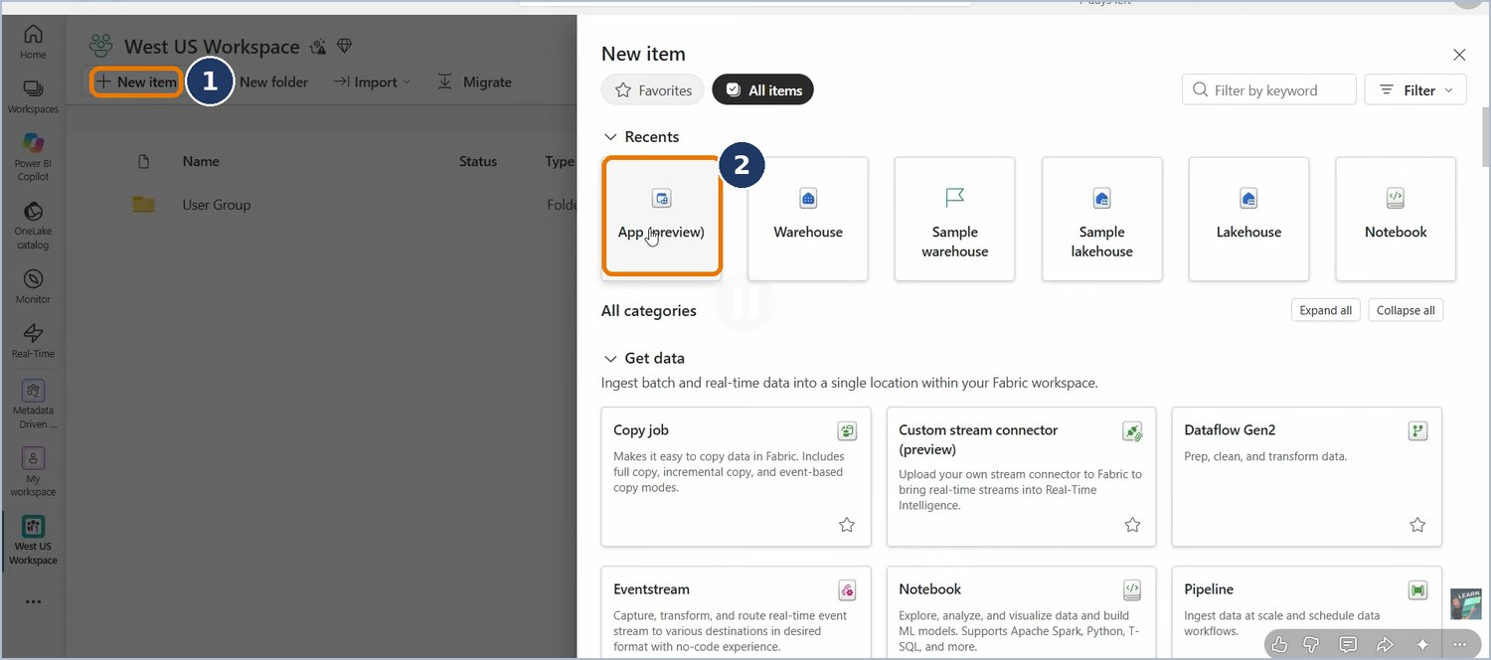
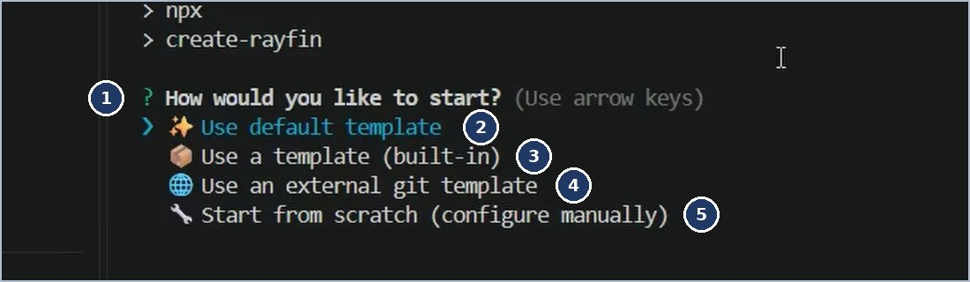
Six ways to start, one App at the end
06 · HOW WE BUILD
Command line
Fabric portal
npm create, then npx rayfin up. Full control, scriptable.
New item → App (preview). Its page shows the command to run.
AI agent
VS Code
Paste “Copy prompt” or use the Rayfin plugin; the agent runs the commands.
Command Palette → “Project Rayfin: Up: Deploy to Fabric”.
Portal: + New item → App (preview)
CI/CD pipeline
Power BI Desktop · coming
GitHub Actions runs npx rayfin up on merge. Sign-in still evolving.
“Modern report” builder with Copilot; shown as a sneak peek.
Command line: “How would you like to start?”
Screenshots: “Microsoft Fabric Apps Explained” (YouTube)
06 · How we build

Slide 39
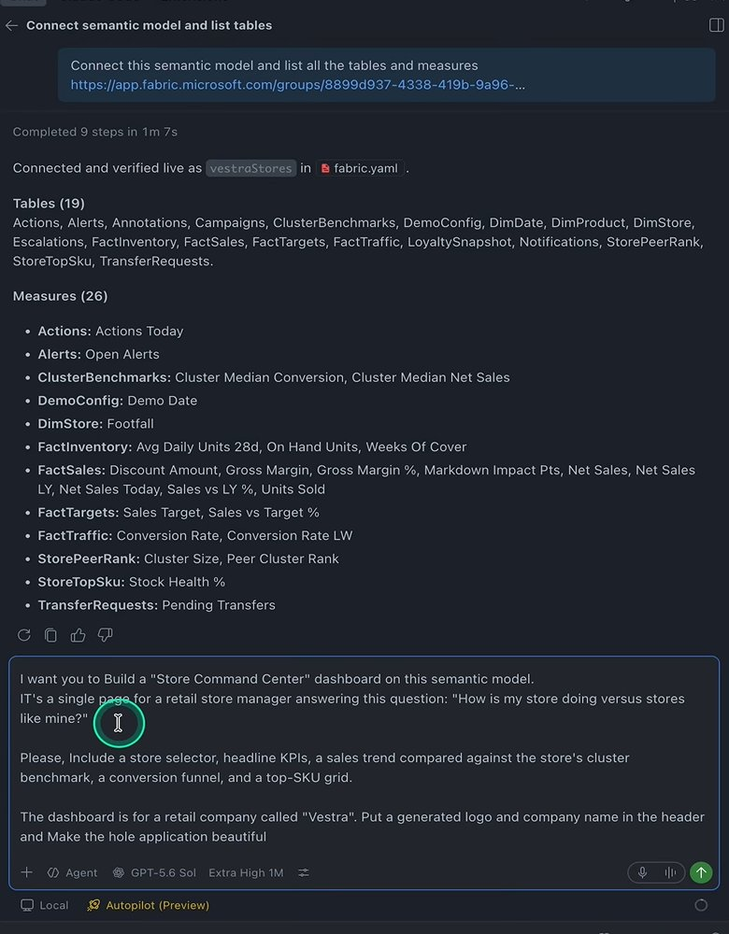
Built with an AI coding agent
06 · HOW WE BUILD
EVERY PROJECT SHIPS AI CONTEXT
AGENTS.md rules
Skills: DAX, design, validation
Docs server (MCP)
HOW THE AGENT WORKS ON A DATA APP
1
2
3
4
Reads the model’s tables and measures
Writes and tests each DAX query
Designs with our colour tokens
Checks the app inside Fabric
Built-in guardrails
Never mock data · never guess column names · ask before adding a data source · keep logic in the model
Works with GitHub Copilot, Claude Code, Codex, Cursor and Gemini. A short written spec per app keeps results consistent.
Agent connects a model, lists 19 tables and 26 measures. Source: Mehdi Maachou
Microsoft Fabric Apps · Briefing
06 · How we build

Slide 40
The web technology underneath, on one page
06 · HOW WE BUILD
LANGUAGE
PAGES AND LOOK
CHARTS
TypeScript
React 19
Tailwind 4
shadcn/ui
Vega-Lite
Data grid
JavaScript with types; the whole app
Components and styling
Visuals fed by DAX results
BUILD AND TEST
DATA ACCESS
TOOLING
Vite 7
Vitest
Playwright
GraphQL
DAX
Rayfin SDK
Node.js + npm
Git
VS Code
Bundles the site; automated tests
How pages read and write data
Run, version and edit the project
The AI agent writes much of this code. Our team still needs people who can review, test and own it.
Versions from the data app template (Rayfin 1.36.2)
06 · How we build

Slide 41
Inside a data app: each visual is a few small files
06 · HOW WE BUILD
sales-trend.dax
sales-trend.json
sales-trend.ts
The visual
The query, reusing model measures by name
The chart design (Vega-Lite)
Joins query, column names and chart
Runs the query, draws the chart
SALES-TREND.DAX
Placeholders
EVALUATE
SUMMARIZECOLUMNS (
'Date'[Month],
TREATAS ( { {{YEAR}} }, 'Date'[Year] ),
"Net Sales", [Net Sales]
)
{{YEAR}} is filled in when the user picks a year, giving a new query.
House rules
One EVALUATE per query · column names exactly as DAX returns them · recent results cached (64)
Pattern from the data app template’s AGENTS.md
06 · How we build

Slide 42
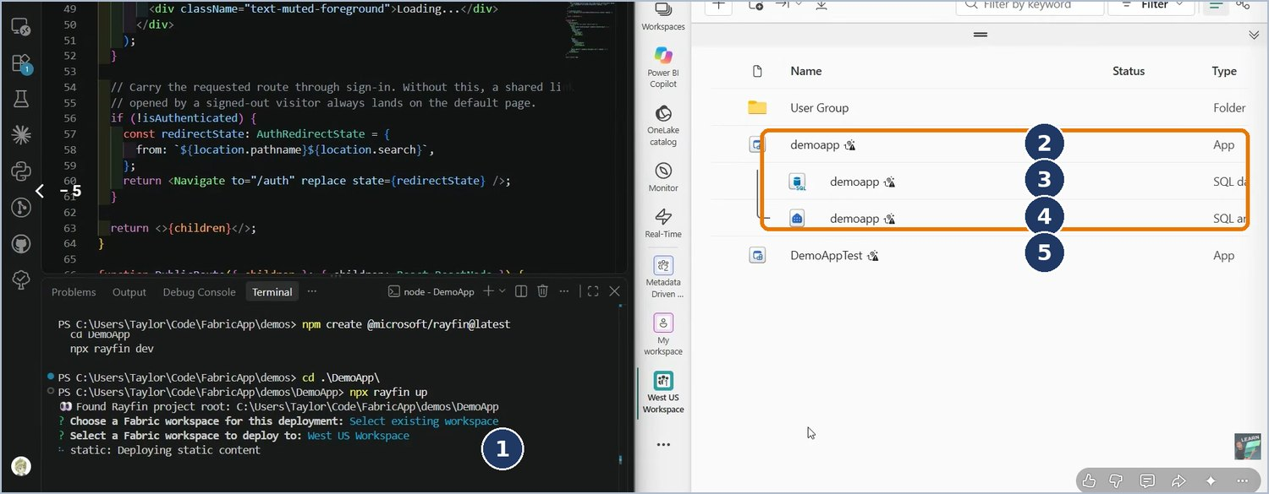
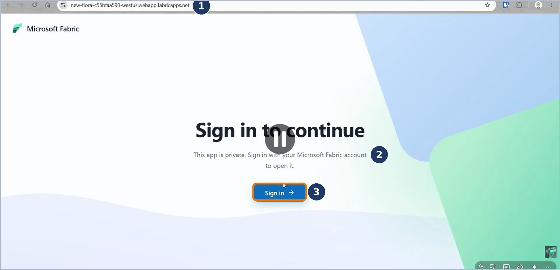
Operational app: stock requests
06 · HOW WE BUILD · USE CASE 1
The need: store staff request stock; managers approve or reject. Today it lives in e-mail and a spreadsheet.
The rules: requesters see only their own requests; an approver sees the ones that name them.
HOW IT WAS BUILT
New item → App, or start from the command line
Define the StockRequest table and its role rules
Agent builds three pages: request, approve, history
npx rayfin up deploys everything
Share the Live URL; users sign in once
Optional: notify by function, read products from the warehouse
After npx rayfin up: the App and its children appear
Opening the Live URL: a private app asks users to sign in
Screenshots: “Microsoft Fabric Apps Explained” (YouTube)
06 · How we build

Slide 43
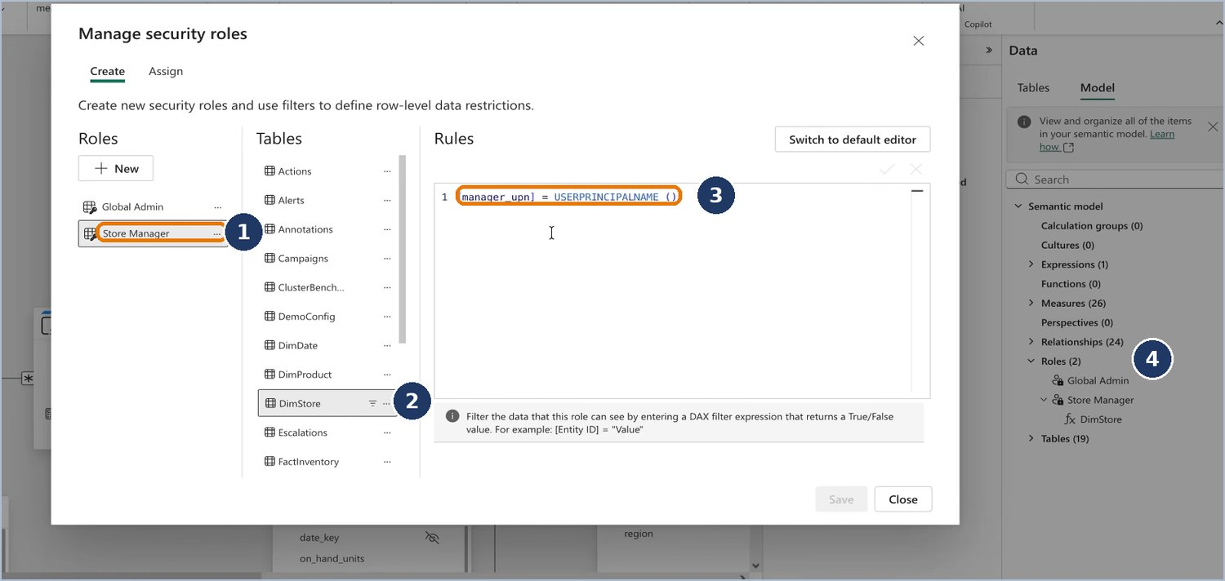
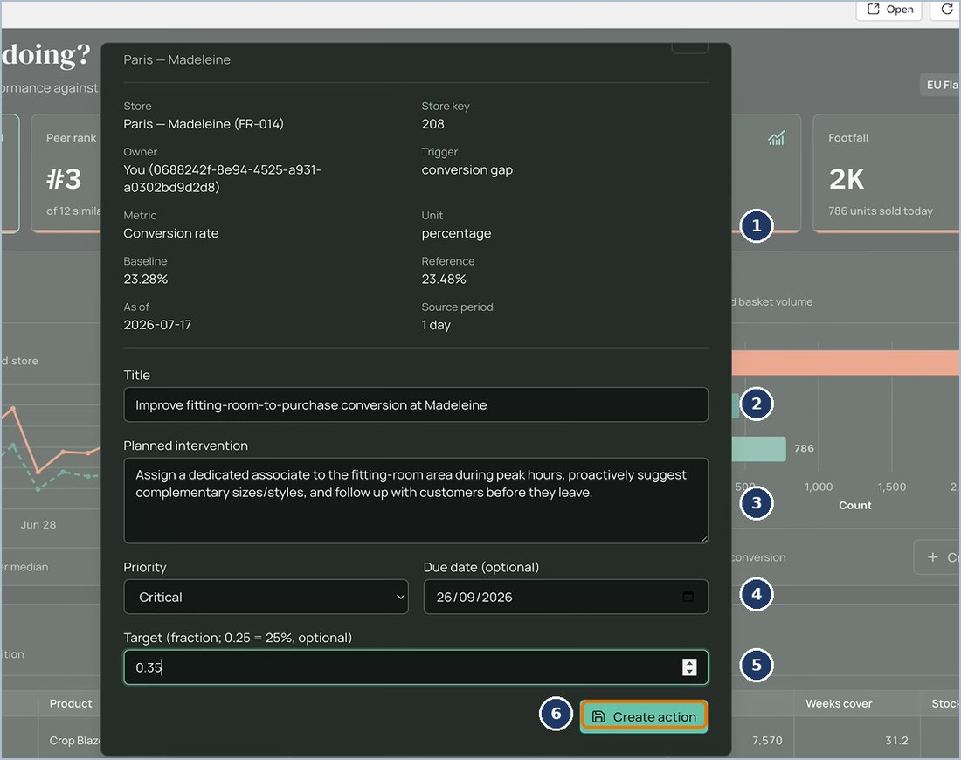
Data app: store command centre
06 · HOW WE BUILD · USE CASE 2
The need: a branded “How is my store doing?” page with peer comparisons — beyond a report layout.
The data: the existing, trusted semantic model, with RLS by store manager.
HOW IT WAS BUILT
Scaffold with the dataapp template
Deploy the empty shell first
Agent connects the model, lists tables and measures
Agent writes DAX and visuals; we check numbers against the report
Add a “Create action” form: now a hybrid app
RLS lives in the model: each manager sees only their stores — no app code
Write-back
The form saves an action plan to the app’s own SQL database. The model is never written to.
Screenshots: Mehdi Maachou, “Build Your First Fabric App with AI” (YouTube)
06 · How we build

Slide 44

How an app reaches its users
07 · SHARE, SECURE, GOVERN
SHARE IN FOUR MOVES
APP ITEM PERMISSIONS
1
Deploy, then copy the Live URL from the App page
Run and interact
Open and use the app. All workspace members get it by default.
2
Share the App item with a security group: Run and interact
Edit
3
Data apps: give the same group Read + Build on the model
Deploy code, change schema and settings. Developers only.
4
Users open the link, or the app inside Fabric; deep links work
Reshare
Pass access on to others. Needs workspace Admin.
External customers: sharing outside our tenant is not documented for Fabric Apps yet. Validate guest (B2B) access or embedding before we commit.
Microsoft Fabric Apps · Briefing
07 · Share, secure, govern

Slide 45
Security in seven layers
07 · SHARE, SECURE, GOVERN
The page is not a security boundary. Each layer must hold on its own; layers 3, 5 and 6 run on the server.
1 · Tenant
Fabric Apps setting · anonymous access off · Execute Queries API
2 · Workspace
Roles · capacity and region · separate dev, test and prod
3 · App item
Run and interact · Edit · Reshare
4 · Sign-in
Fabric single sign-on · embed host or token exchange · static files protected
5 · Data rules
Entity role rules · row policies on user claims · field include / exclude
6 · Sources
Model RLS / OLS · app vs delegated identity · secure the child SQL database
7 · Code and supply
Secrets server-side only · lock and audit packages · review every agent change
Preview gaps to weigh: no private links and no outbound access protection yet.
Microsoft Fabric Apps · Briefing
07 · Share, secure, govern

Slide 46

One rule protects every page and API call
07 · SHARE, SECURE, GOVERN
WHAT ANNA GETS BACK
RAYFIN/DATA/STOCK-REQUEST.TS
@entity()
@authenticated(['create', 'read', 'update'], {
policy: (claims, item) =>
claims.sub.eq(item.user_id),
})
export class StockRequest { … }
Id | Request | Owner
101 | 20 × shelf labels | Anna
102 | Printer toner | Ben
103 | Hand scanners | Anna
104 | Cleaning kit | Chen
Signed-in users may create, read and update only their own rows
Rules can use the user id, email and role; fields can be hidden
Enforced by the Data API
Test every rule with at least two real accounts
Grey rows never leave the server, whichever page or tool asks.
Illustrative example; syntax from the Rayfin data model docs
07 · Share, secure, govern

Slide 47
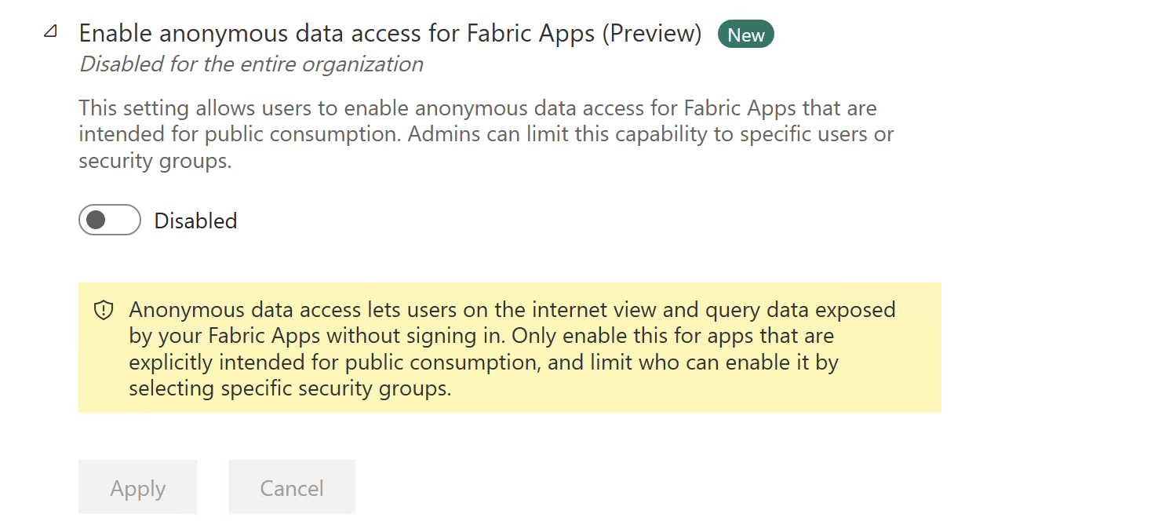
Three admin switches
07 · SHARE, SECURE, GOVERN
Tenant setting | Default | Our recommendation
Fabric Apps (preview) | Off | On for a trained creators group first
Anonymous data access for Fabric Apps | Off | Keep off unless a public use case is reviewed
Semantic Model Execute Queries REST API | Varies | Required for data apps; scope to the groups that need it
Admin portal: the anonymous access switch. Source: Microsoft Learn
Where
During preview
Admin portal → Tenant settings. Execute Queries sits under Integration settings.
Scope each switch to security groups, never the whole organisation.
Microsoft Fabric Apps · Briefing
07 · Share, secure, govern

Slide 48

A light governance lifecycle
07 · SHARE, SECURE, GOVERN
Request
Approve
Build in dev
Review
Promote
Monitor
Retire
Who can create
Where
Ownership
A trained “Fabric App creators” group, set in the tenant switch
Dev workspaces to build; one production workspace per business area
A business and a technical owner; the App owner’s access matters
Review gates
Inventory
Retirement
Code review, security checklist, numbers vs the model, accessibility
Apps, owners, sources, users and costs, reviewed each quarter
Remove sharing, export the data, then delete the App and its children
Microsoft Fabric Apps · Briefing
07 · Share, secure, govern

Slide 49




Consistency across many apps
07 · SHARE, SECURE, GOVERN
Every app is code and every agent improvises. Without shared standards, ten apps become ten styles.
House template
Design tokens
AI context
Shared parts
Our stack, pages and rules in one template, pinned by tag and registered for every builder.
Colours, fonts and spacing defined once; pages and charts use the names, never raw values.
AGENTS.md rules, skills for one job each, and a short spec per change.
KPI cards, filters and charts in an internal package, not copied between apps.
Automate the rules: lint for stray colours · build and tests on every change · package audit · visual check in Fabric before promotion
Microsoft Fabric Apps · Briefing
07 · Share, secure, govern

Slide 50
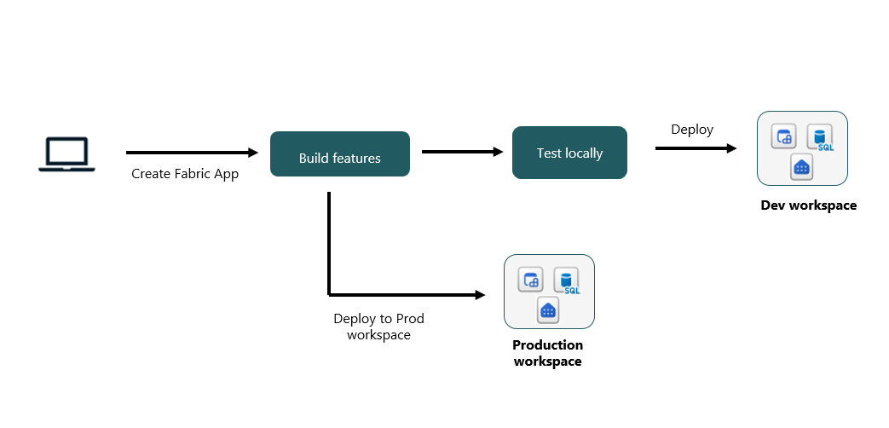
Dev, test and prod: promoting an app
08 · RUNNING IT
CLI per workspace
Works today
Deploy the same reviewed commit to each workspace in turn.
GitHub Actions
Emerging
Service principal sign-in: Microsoft sources disagree. Test first.
Deployment pipelines
Emerging
Rayfin docs support it; the Learn FAQ still says ALM isn’t supported.
Same code, separate workspaces. Source: Microsoft Learn
Data doesn’t move between stages: each App’s database starts empty.
Rollback = deploy the previous commit. Export data before dropping columns.
Status as of November 2026
08 · Running it

Slide 51
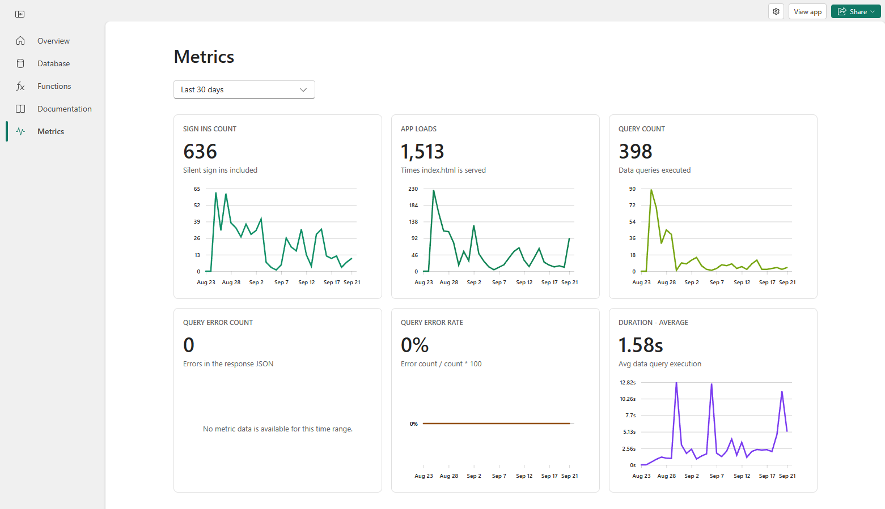

Monitoring: the App’s Metrics tab
08 · RUNNING IT
Sign-ins
Includes silent re-sign-ins; not unique users
App loads
Times the app’s start page loaded
Query count
GraphQL reads and writes, failures included
Query errors · rate
Errors can arrive with HTTP 200
Average duration
Server-side time · last 24 h, 7 or 30 days
Metrics tab. Source: Microsoft Learn
Data app DAX queries run on the model’s capacity: watch them in the Capacity Metrics app, like report queries.
Microsoft Fabric Apps · Briefing
08 · Running it

Slide 52
What it costs: metered on Fabric capacity
08 · RUNNING IT
THREE BILLS TO TRACK
Meter | How it is charged
SQL database | SQL usage + allocated storage; 1 CU = 0.383 SQL vCores
GraphQL Data API | 10 CU per hour of processing time
Static hosting | OneLake read, write and storage
Functions | User Data Functions execution
Model queries | Charged where the model lives, like report queries
No charge | Rayfin web service, sign-in, deployments
1 · AI tokens
While building, for the coding agent
2 · Capacity units
While running, on the app’s workspace
3 · Model capacity
Data app queries, where the model lives
Watch it in the Fabric Capacity Metrics app, per item.
Pro / PPU: no extra cost up to 1 GB per app — announced, rolling out.
Source: Microsoft Learn — Fabric Apps capacity and billing
08 · Running it

Slide 53

Numbers and limits to know
08 · RUNNING IT
100 MB
100k
120/min
1
per frontend deploy
rows per DAX query (or 1M values)
DAX queries per user
EVALUATE per query call
100k
64
2–5 min
1 GB
max rows per GraphQL page (default 100)
cached query results by default
first deploy; 30–60 s after
per app on Pro/PPU (announced)
Preview gaps: no private links · no outbound access protection · limited regions · no Git integration for App items yet
Microsoft Learn, Rayfin docs 1.36.2
08 · Running it

Slide 54

Should this be a Fabric App?
09 · DECISION AND ROLLOUT
1 · Mainly reading and analysing data?
Power BI report
A standard report meets the layout, interaction and audience
yes
↓ no
2 · Only a small write action inside a report?
Translytical task flow
Approve a row, add a comment, adjust a value
yes
↓ no
3 · Low-code makers or Microsoft 365 connectors?
Power Apps
SharePoint lists, Outlook, Teams approvals
yes
↓ no
4 · Custom app or analytics on Fabric data, with code + AI?
Fabric App
Read-only → data app · records → operational · both → hybrid
yes
Still unsure? Prototype in a report first. Move to an app when the report’s limits block real users — not because apps look modern.
Microsoft Fabric Apps · Briefing
09 · Decision and rollout

Slide 55
Report or data app: the honest trade-offs
09 · DECISION AND ROLLOUT
YOU GAIN WITH A DATA APP
YOU GIVE UP, OR MUST CODE
Any layout, branding and navigation
Guided, multi-step flows
Visuals Power BI cannot draw
Write-back next to the numbers
Several models and Fabric items in one app
Deep links and embedding
Drag-and-drop editing by business users
Built-in cross-filter, drill and tooltips
Export, subscriptions, Analyze in Excel
Copilot and Q&A in the report
Some speed: ~0.76 s vs ~0.52 s per visual in one test
Ongoing code maintenance and review
The semantic model stays the single source of truth for both. Keep business logic in DAX measures, not in app code.
Speed figure: Data Goblins, “What are Fabric Apps?” (illustrative, one test)
09 · Decision and rollout

Slide 56
Preview status and open points
09 · DECISION AND ROLLOUT
Public preview since
Open point | What we know | Our action
AAS-hosted models | Query API doesn’t support them | Assess migration
External customers | Not documented for Apps | Validate guest / embed
Pipeline sign-in | Sources disagree | Test in our tenant
ALM | Rayfin docs yes; Learn FAQ no | CLI per workspace now
Network | No private links yet | Check against policy
Regions | Limited in preview | Confirm our region
Pro / PPU | Docs not yet updated | Recheck before sizing
2 June 2026
Rayfin, open source
v1.36.2
Pro / PPU announced
28 Sep 2026
Status as of 10 November 2026
09 · Decision and rollout

Slide 57

Proposed rollout in four phases
09 · DECISION AND ROLLOUT
1 · Enable
2 · Pilot
3 · Standardise
4 · Scale
Apps setting for a pilot group
Execute Queries setting
Dev workspace on F capacity
Tools for 2–3 builders
One operational app
One data app on a Fabric model
Security checklist passed
House template and tokens
AGENTS.md and checklists
Governance lifecycle
Promotion route chosen
Creators group and training
Production workspaces
Inventory and cost review
Done when: quarterly review is running
Done when: an empty app is deployed
Done when: real users, numbers match the reports
Done when: a second team builds from the template
In parallel: trial the AAS migration on one model, and validate how customers would sign in.
Proposal for discussion; dates to be agreed
09 · Decision and rollout

Slide 58

What we are asking for today
09 · DECISION AND ROLLOUT
1
Switch it on for a pilot group
2
A dev workspace
Fabric Apps and Execute Queries tenant settings, scoped to a security group.
On Fabric capacity (or a trial), for two or three builders.
3
Two pilot use cases
4
An AAS migration check
One operational app now; one data app on a Fabric semantic model.
Trial-migrate one AAS model, and confirm how customers would sign in.
What comes back: a working pilot demo, plus findings on the AAS migration and customer access.
Microsoft Fabric Apps · Briefing
09 · Decision and rollout

Slide 59
Sources
APPENDIX
MICROSOFT DOCUMENTATION
COMMUNITY AND SCREENSHOTS
Microsoft Learn — Fabric Apps (overview, data apps, admin settings, metrics, capacity and billing, dev/prod workflow, FAQ)
Power BI REST API — Execute Queries and Execute DAX Queries (limitations)
Microsoft Learn — Migrate Azure Analysis Services to Power BI
Rayfin on GitHub (microsoft/rayfin) and CLI docs, v1.36.2
Data app template (microsoft/fabric-apps-analytic-templates)
Data Goblins (Kurt Buhler) — “What are Fabric Apps?”
Aleksi Partanen, Taylor Amy, Teemu Multanen — “Microsoft Fabric Apps Explained”
Mehdi Maachou — “Build Your First Microsoft Fabric App with AI”
element61 — “Fabric just became an application platform”
Forward Forever — showcase images
Preview features change quickly. Facts checked on 10 November 2026; recheck open points before each decision.
Microsoft Fabric Apps · Briefing
Appendix

Slide 60
Fabric Apps let us build the apps reports can’t be — on data we already govern.
IN ONE SENTENCE
Now
Next
Then
Pilot an operational app
Migrate one AAS model, then a data app
Standardise and scale
Questions and discussion

